Slide 1
Product Backlog (User Stories)
Amir Dirin Spring 2023

Slide 2
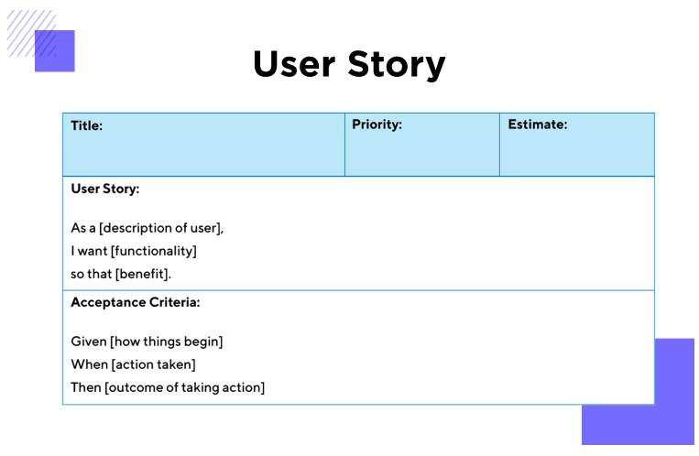
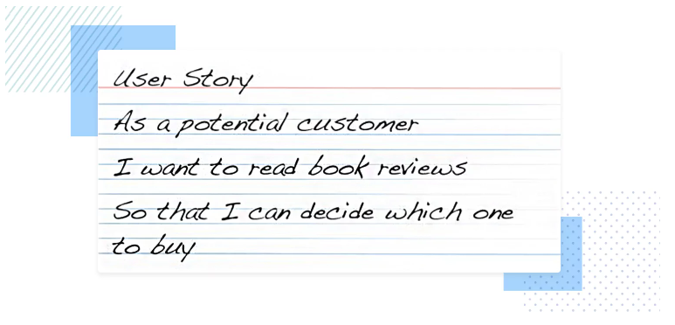
Product Backlog (User Stories)
As a team you have to come up with your product backlog. Use the user story approach to write done the product backlog.
User Stories:
“As a [persona], I [want to], [so that].”
https://www.justinmind.com/blog/user-story-examples/

Slide 3
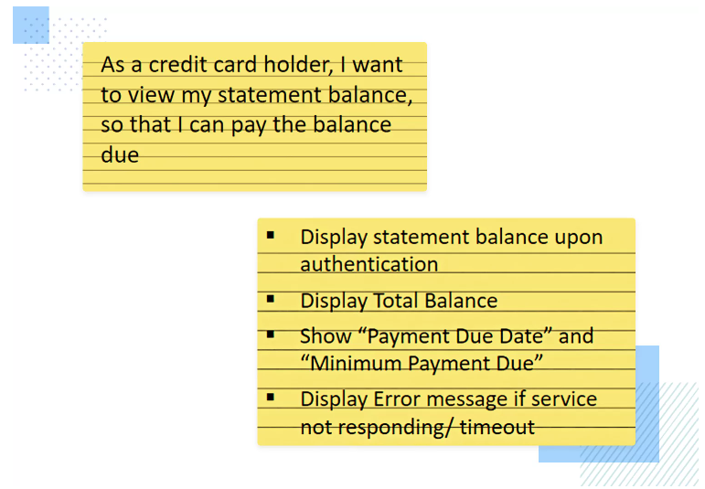

Slide 4
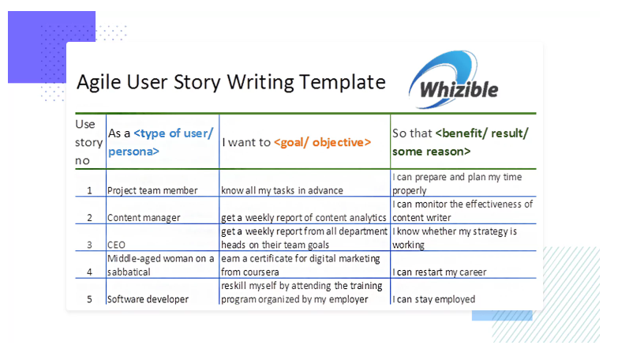
Example contiue

Slide 5
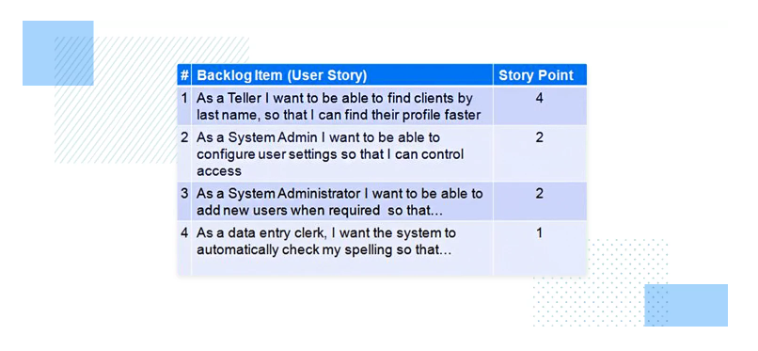

Slide 6
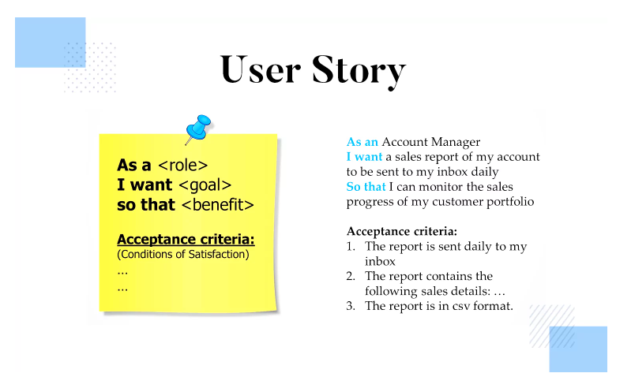

Slide 7
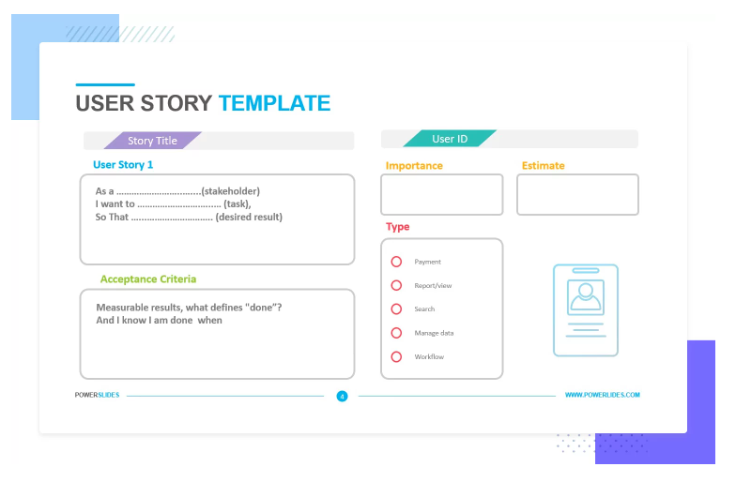
Example

Slide 8
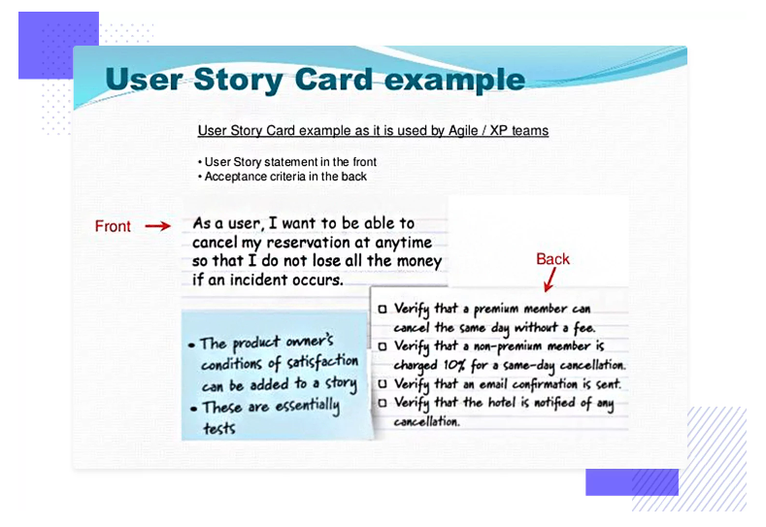
Example

Slide 9
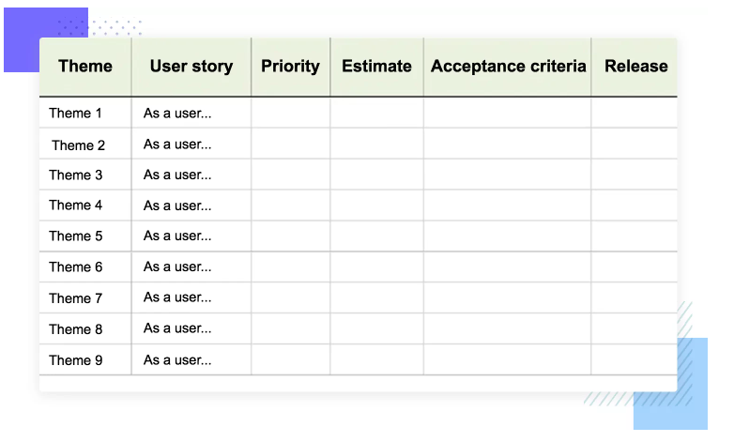

Slide 10
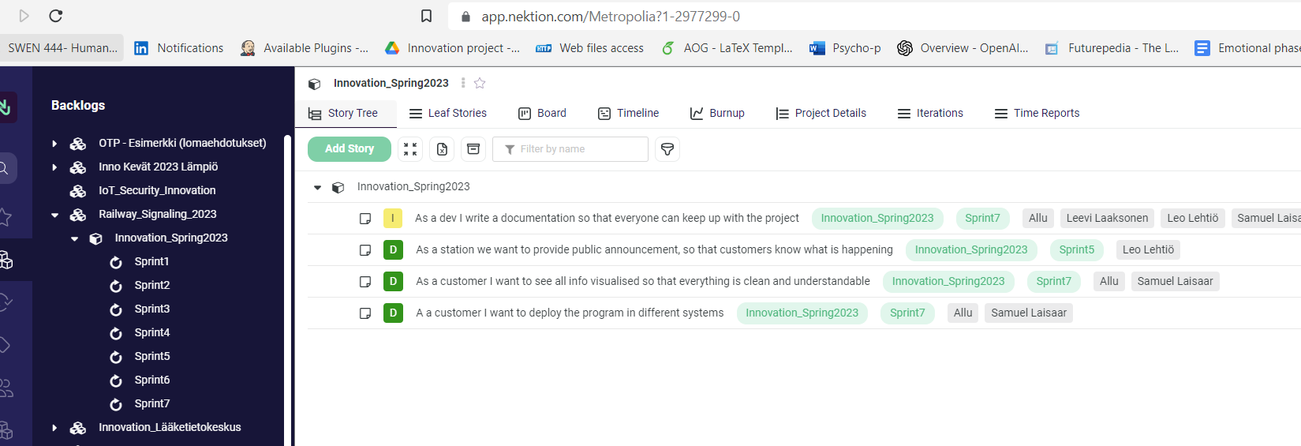
Introduction to NektioN
https://app.nektion.com/Metropolia

Slide 11
Nektion Concept
Create product portfolios, development portfolios, application portfolios, or any other portfolio you need. Hierarchies such as program increments and sprints, products, and product releases are easily added to your portfolios.

Slide 12
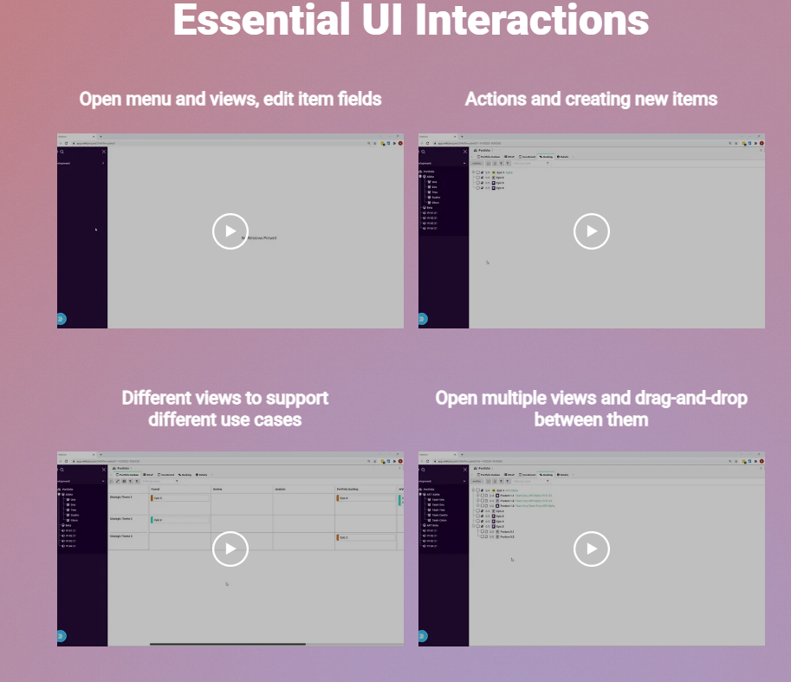
Assignment of the week
Learn about Nektion at https://www.nektion.com/for-users

